Slide 1

Financial inclusion and small business development in Mexico
Guillermo Ávila – Pablo Abiud – Ximena Fernández – Salvador Zárate

Slide 2
Hipothesis
The main hipothesis of our Project is that in places where more financial services are offered, small businesses (30 employees or less) have more development leading also to better life conditions.

Slide 3
Questions
Is there any relation between the financial services offered and the quantity of small businesses?
Is there a relation between financial services, the development of small businesses and social disadvantage?
Do the poorer states have less access to financial services?

Slide 4
Data Sources
DENUE
Indice de rezago social (CONEVAL)
Comision Nacional Bancaria y de Valores Geographic database

Slide 5
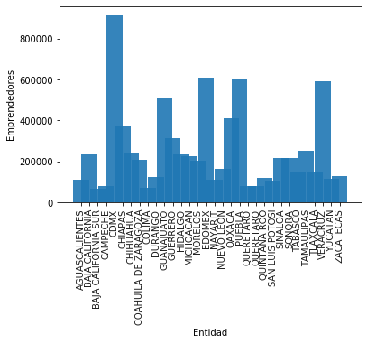

Slide 6
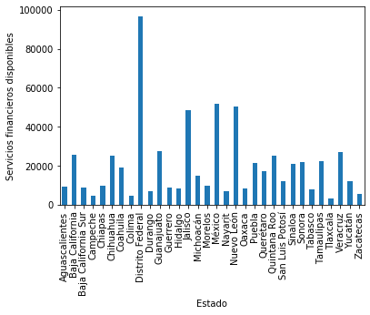

Slide 7
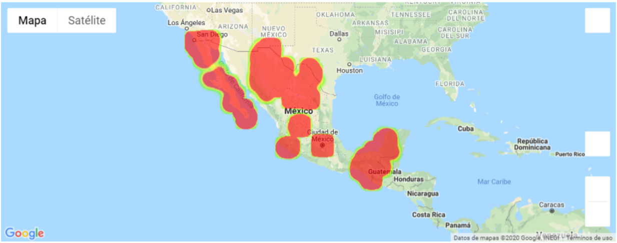
Pequeñas empresas

Slide 8
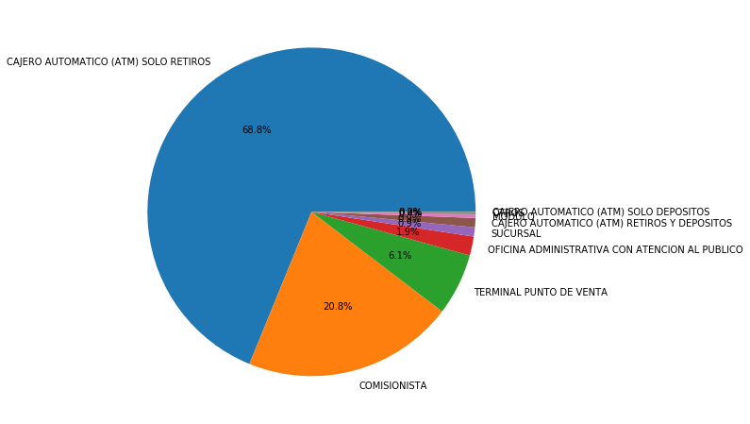
Servicios financieros

Slide 9
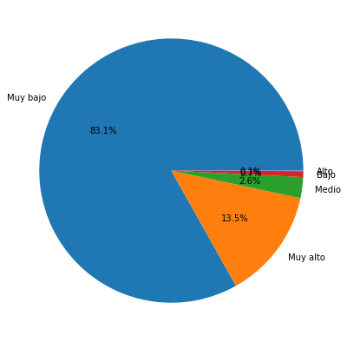
Rezago Social

